Slide 1


Thematic Analysis of
Banking Regulatory Changes
—-—-—-Following the Collapse OF SVB
Group 1
Priscilla Clark
Nicholas Wong
Harsh Kumar
Elaine Zhang
Group 1

Slide 2



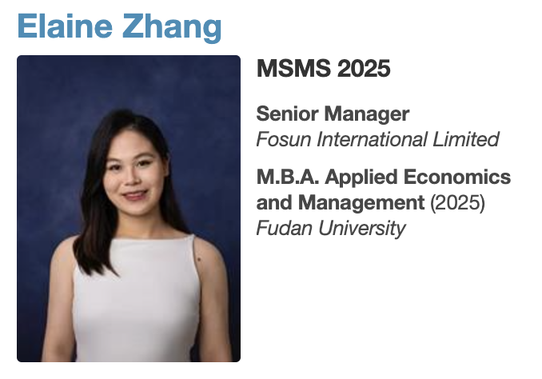
TEAM
Harsh Kumar (MFin 2026)
Priscilla Clark (Sloan Fellow 2025)
Nicholas Wong (MFin 2026)
Elaine Zhang (MSMS 2025)
Notes:
Elaine

Slide 3

INTRODUCTION
Background：
The collapse of Silicon Valley Bank (SVB) in 2023 marked a critical juncture for the financial industry, highlighting vulnerabilities in small bank governance and liquidity management.
Research Objectives：
Our study aims to examine how regulatory focus shifted in response to the SVB collapse, providing insights to financial institutions on the expected magnitude and timing of new rules related to the root causes of the crisis.
Notes:
Elaine

Slide 4

The Collapse of Silicon Valley Bank (SVB)
1
1983
SVB was established as a leading financial institution for tech startups and venture-backed firms.
3
March 9, 2023
A bank run ensued as clients withdrew $42 billion from SVB in a single day.
March 8, 2023
4
March 10, 2023
2
SVB was closed by regulators and placed under FDIC receivership, marking one of the largest U.S. bank failures since the 2008 financial crisis.
SVB announced a $1.8 billion loss on bond sales and a plan to raise capital, triggering panic among clients.
Notes:
Elaine

Slide 5



ROOT CAUSE BACKGROUND
Interest Rate Risk Mismanagement
Concentrated Client Base
SVB invested heavily in long-term Treasury bonds and mortgage-backed securities during a period of low interest rates (2020-2021).
As the Federal Reserve aggressively raised rates in 2022-2023 to combat inflation, the value of these bonds plummeted, creating large unrealized losses.
The bank catered primarily to tech startups and venture capital firms, leading to an overreliance on a narrow, high-risk industry prone to volatility.
This also resulted in depositors with large, uninsured accounts above FDIC limits, amplifying withdrawal risks during uncertainty.
Liquidity Shortages
Weak Regulatory Oversight
Rapid withdrawals from tech firms facing funding pressures during an economic slowdown led to a lack of sufficient liquid assets to meet withdrawal demands.
Critics cited insufficient stress testing and regulatory oversight following changes in banking regulations (2018 rollback of Dodd-Frank provisions for midsize banks).
Notes:
Elaine

Slide 6


PROBLEM STATEMENT
Utilize NLP topic modelling
Identify themes in regulatory corpus
Reveal shifts in regulatory focus
Apply techniques like TF-IDF and BERTopic to uncover central topics and their distributions across financial regulatory documents
Analyze a dataset of proposed and implemented regulations from financial service federal regulatory agencies
Track how regulatory themes and priorities change pre and post the collapse of Silicon Valley Bank
HYPOTHESIS: The regulatory focus on the governance of small/mid-sized banks, liquidity, and capital requirements increased in the 18 months after the collapse of SVB.
Notes:
Elaine

Slide 7
RESEARCH PROCESS
Modeling & Validation
Naive
Baseline
Data
Collection
Data
Processing
TF-IDF
Comparative
Analysis
Conclusion
BERTopic
Notes:
The reason for selecting these three models is their complementary strengths: Naive Baseline provides a simple and efficient benchmark, TF-IDF effectively extracts text features, and BERTopic, which incorporates TF-IDF, leverages advanced deep learning models to capture complex semantic information. Using these two models allows for a comparison between simpler and more complex approaches, spanning a range of model complexity. Together, they enable a comprehensive analysis of different aspects of the SVB collapse.

Slide 8
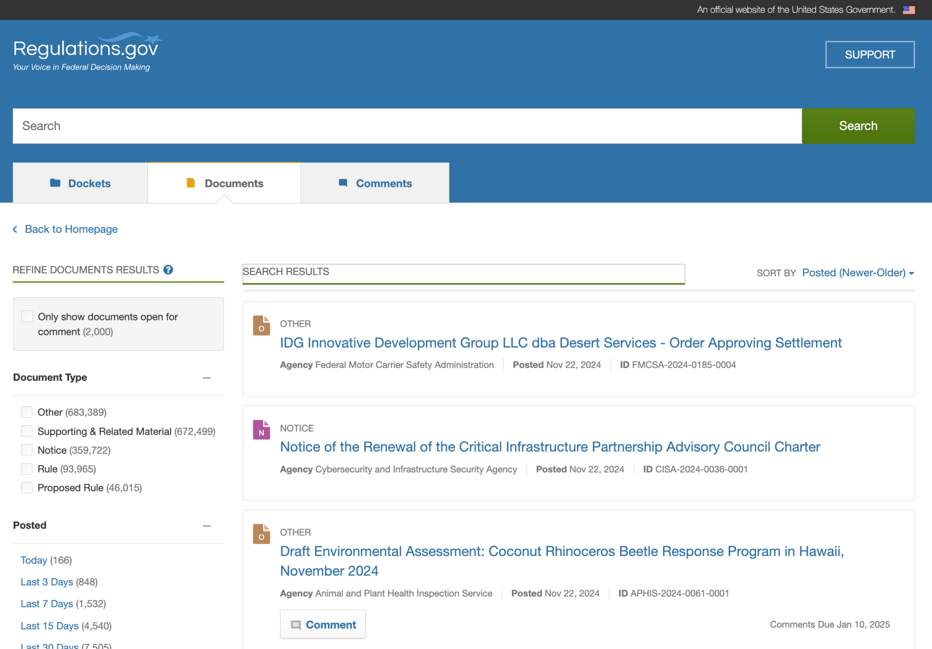
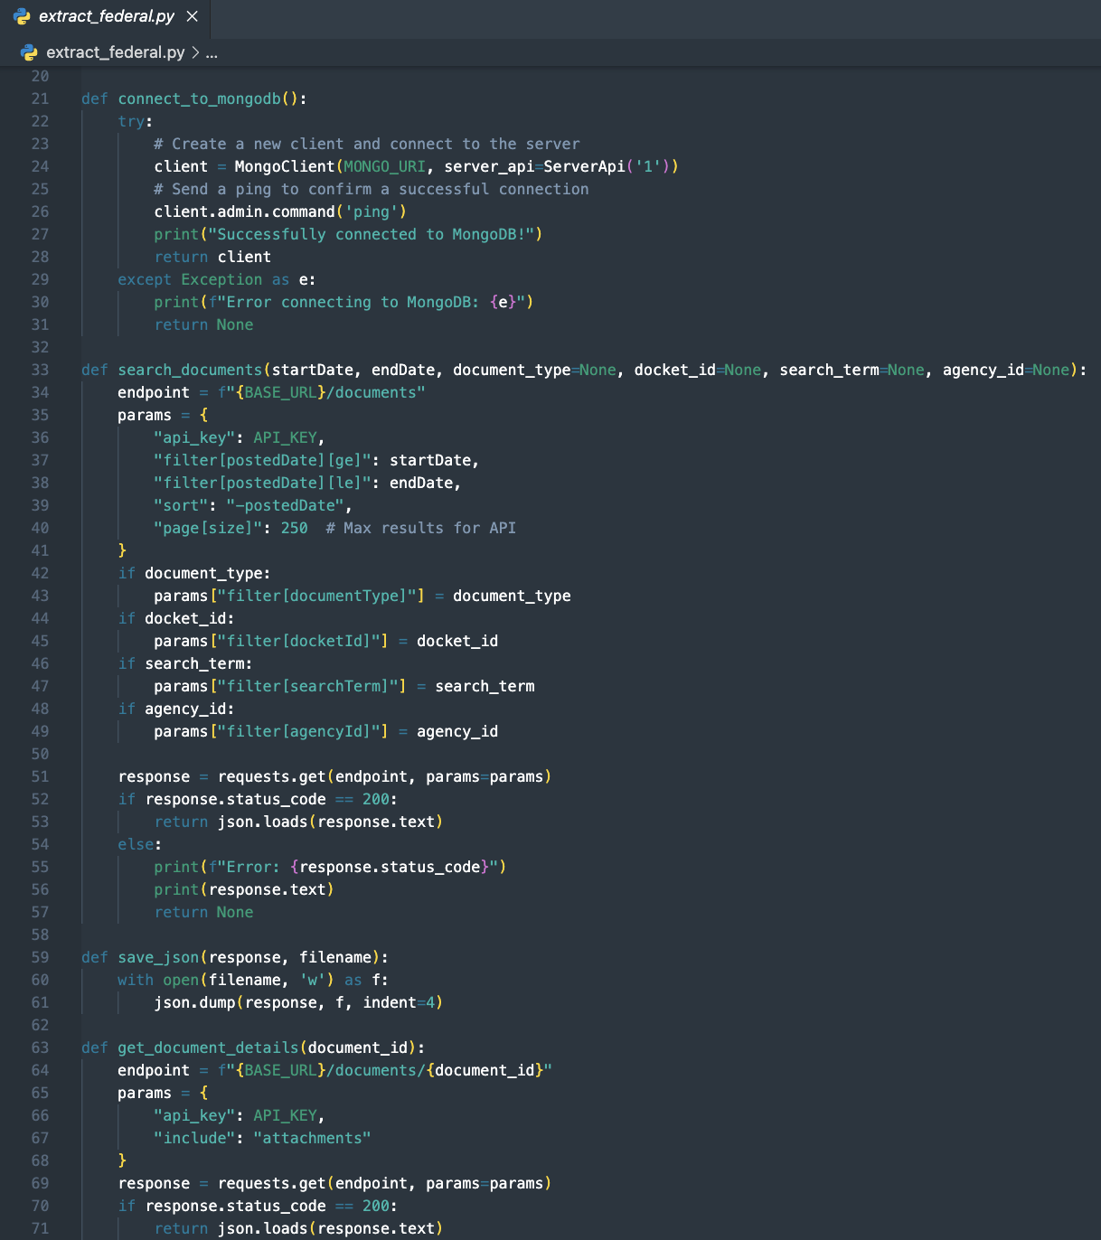
data collection
Documents and metadata were extracted via the Regulations.gov API
Document type: Proposed Rule & Rule
Agencies: Consumer Financial Protection Bureau, Federal Depository Insurance Corporation, Federal Reserve System, Financial Stability Oversight Council, Office of the Comptroller of the Currency, Securities and Exchange Commission, Department of the Treasury
Notes:
Priscilla

Slide 9
Financial Regulatory Agencies
Consumer Financial Protection Bureau (CFPB)
Protects consumers from unfair, deceptive, or abusive practices in the financial sector.
Federal Deposit Insurance Corporation (FDIC)
The FDIC insures bank deposits; examines and supervises financial institutions for safety, soundness, and consumer protection; makes large and complex financial institutions resolvable; and manages receiverships.
Financial Stability Oversight Council (FSOC)
Established in 2010 under the Dodd-Frank Wall Street Reform and Consumer Protection Act, the Financial Stability Oversight Council provides comprehensive monitoring of the stability of our nation's financial system.
Office of the Comptroller of the Currency (OCC)
Charters, regulates, and supervises national banks and federal savings associations.
Securities and Exchange Commission (SEC)
Oversees key participants in the securities industry, including securities exchanges, broker-dealers, investment advisors, and mutual funds.
Department of the Treasury
Responsible for promoting economic prosperity and financial stability, collecting taxes, managing government accounts, and enforcing economic sanctions.
Federal Reserve System
Responsible for monetary policy, bank regulation, and the stability of the financial system.
Notes:
Priscilla

Slide 10
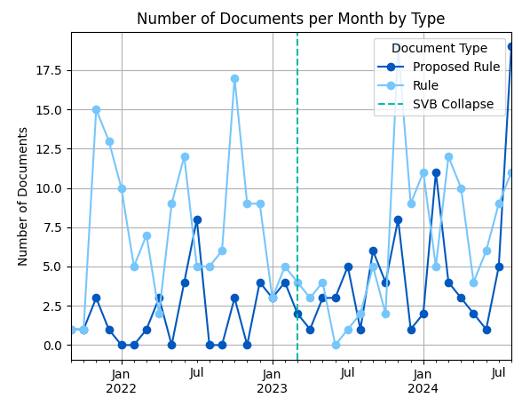
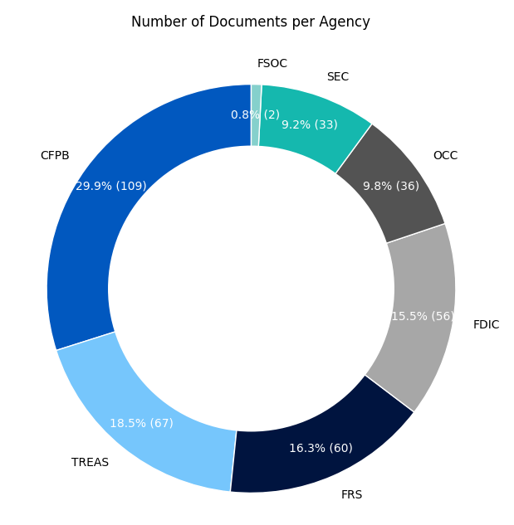
EXPLORATORY DATA ANALYSIS
368 documents span the 18 months before (170) and after (198) March 10th, 2023
Notes:
Priscilla

Slide 11
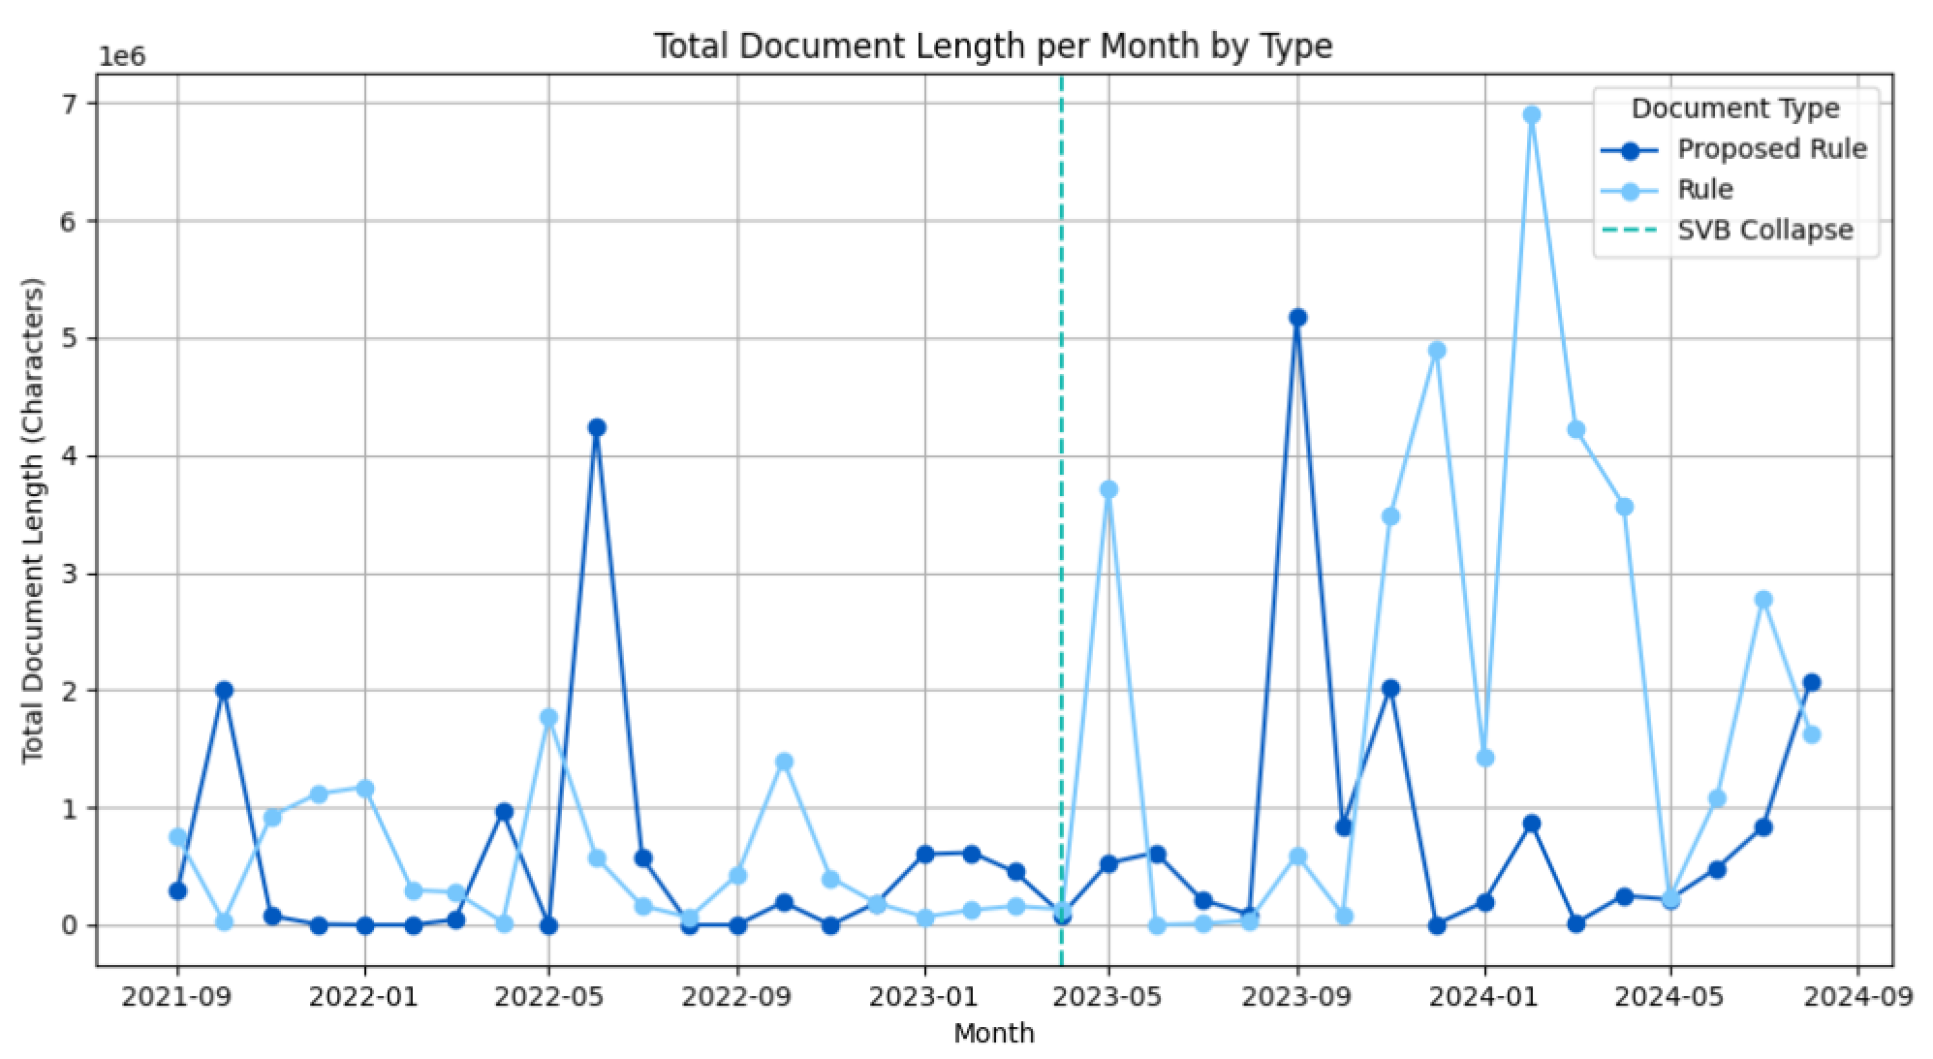
EXPLORATORY DATA ANALYSIS
Notes:
Priscilla

Slide 12
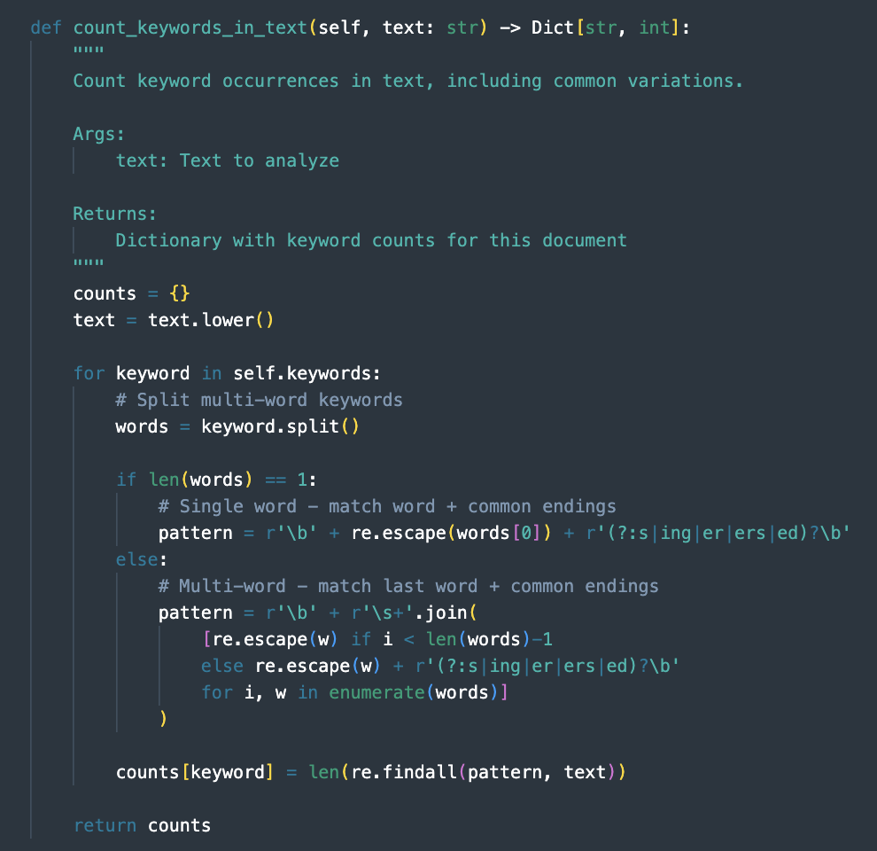
NAIVE MODEL
Naive model conducted a keyword search in the pre/post document populations - results were limited to documents with the keyword appearing more than 3 times
Keywords (regex used to account for different word endings)
liquidity
capital
capital requirement
small bank
mid-sized bank
community bank
interest rate risk
concentration
Poisson regression used for hypothesis testing because:
Events (keyword mentions) are independent
Count data (number of documents mentioning keywords)
Comparing rates across different sample sizes
Pre/post periods may have different total documents
Notes:
Priscilla

Slide 13
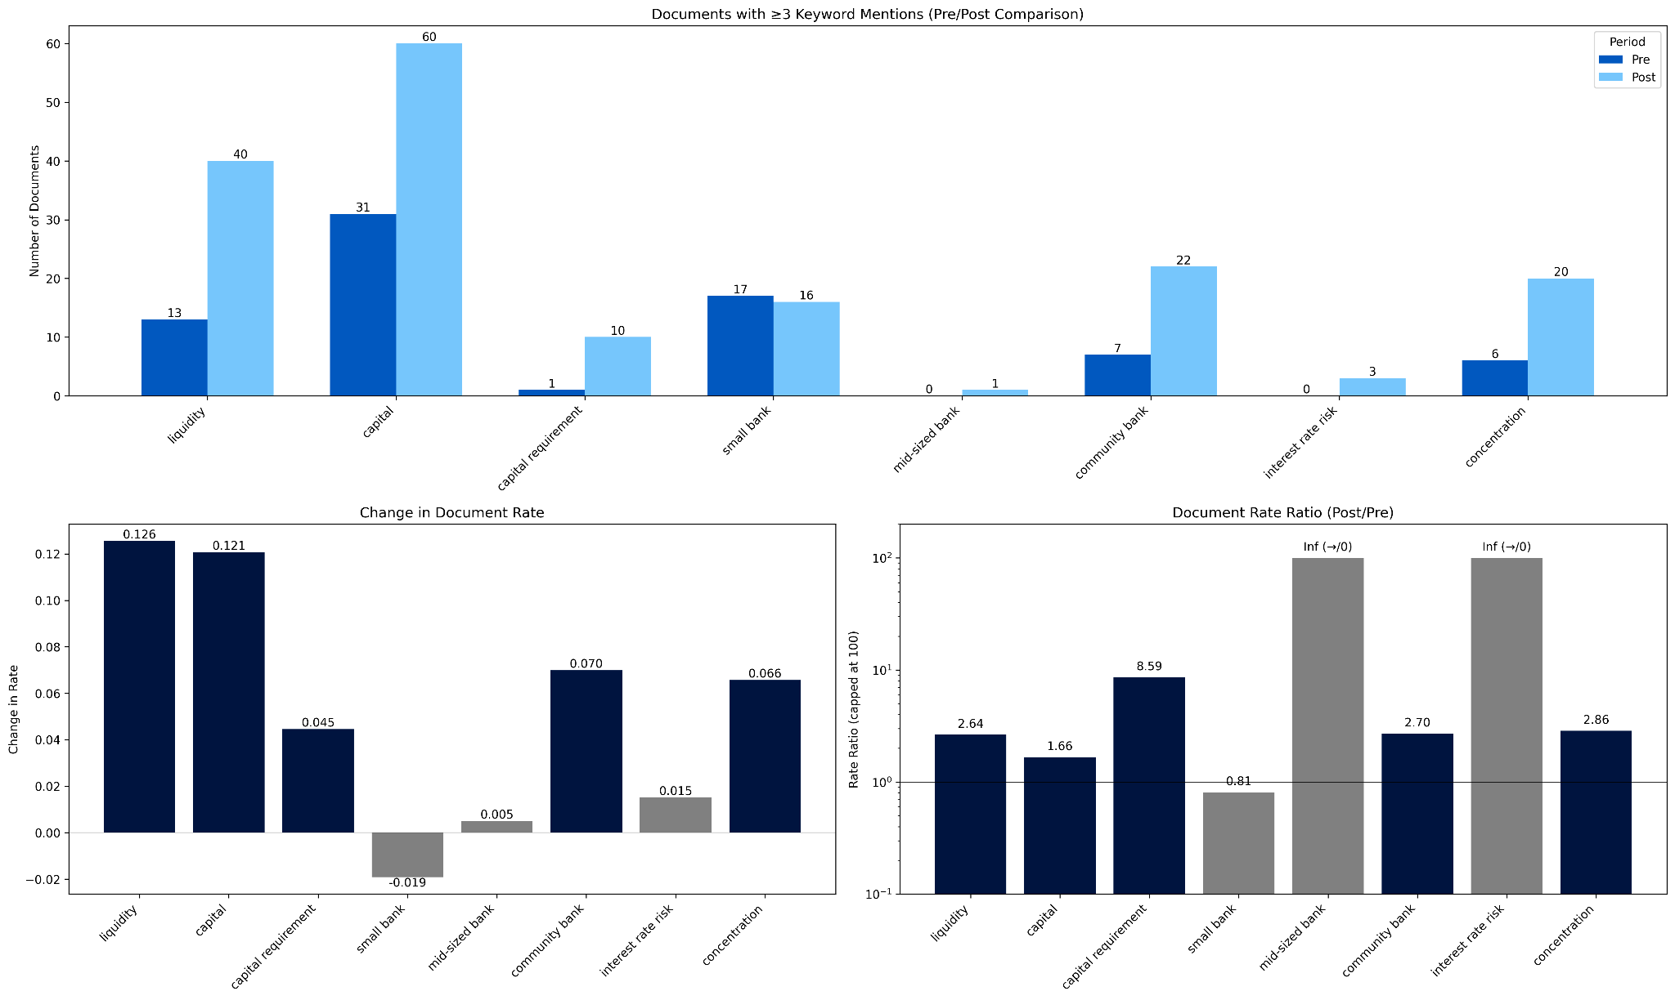
NAIVE MODEL
Five out of the eight keywords have an increase in appearance post-SVB collapse (3/10/2023).
The presence of documents mentioning small bank unexpectedly decreased post-event.
Mid-size bank and interest rate risk emerged as new themes.
Naive model proves our hypothesis for increased focus on liquidity and capital.
Notes:
Priscilla

Slide 14
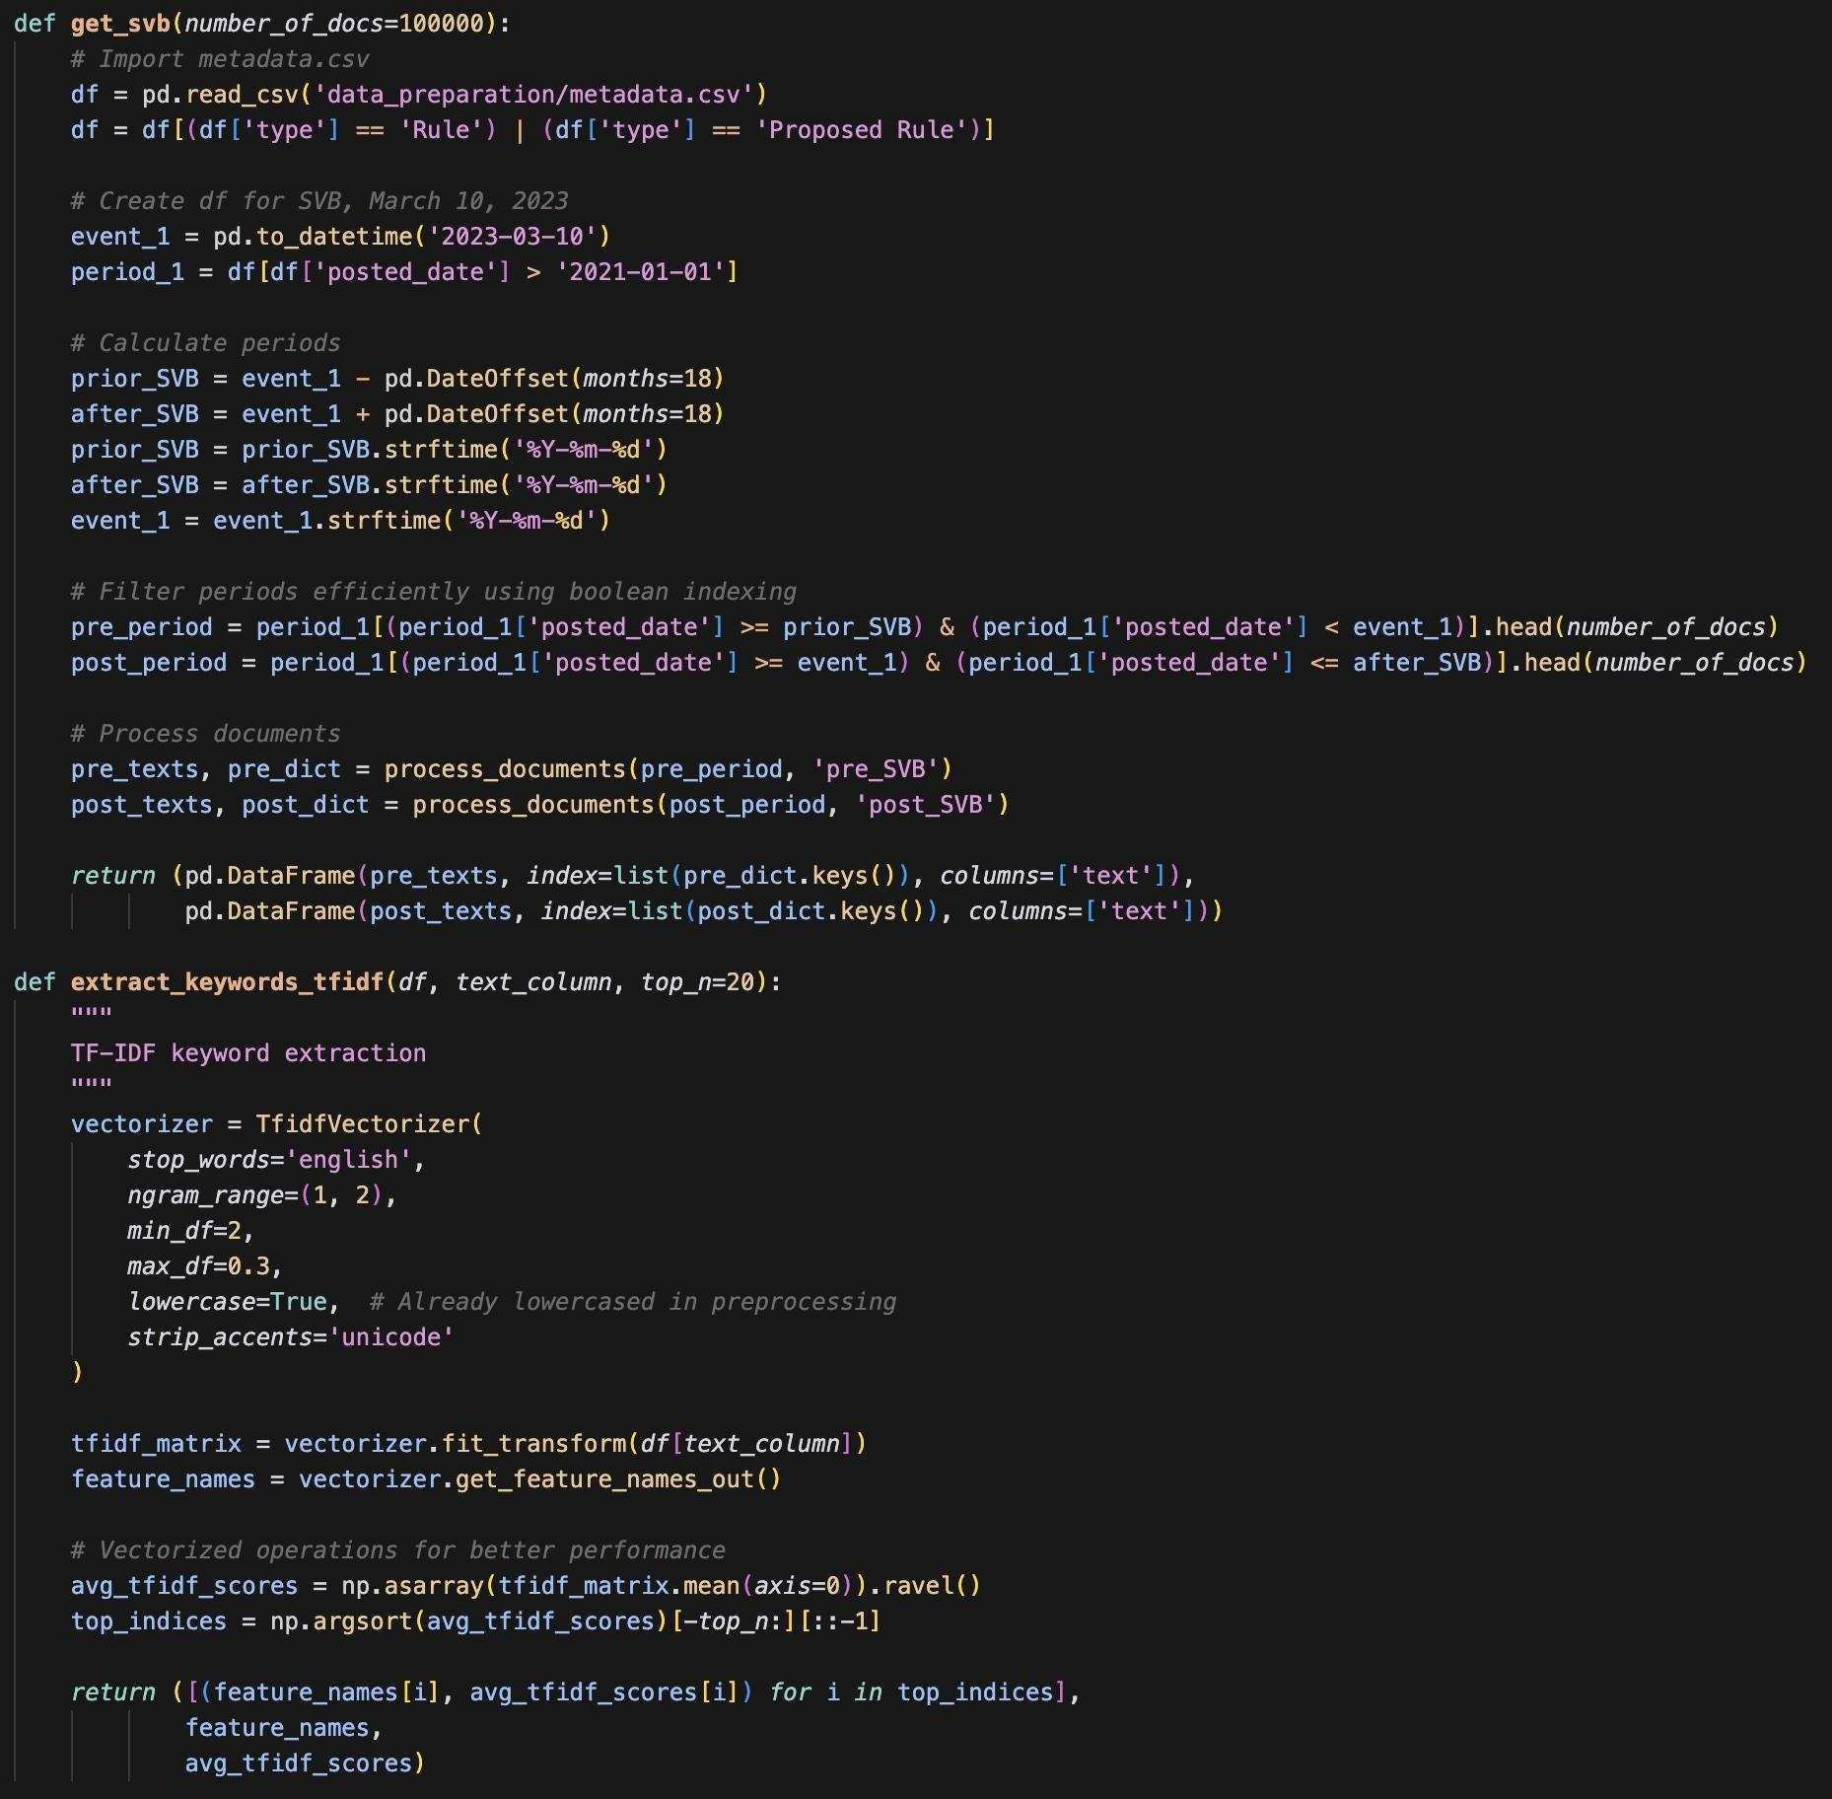
TF-IDF Process
TF-IDF calculated the most important keywords across documents in the pre-SVB collapse period and the post-SVB collapse period and compared them in order to see what new terms were considered important and which terms increased in importance after the collapse.
We process 170 pre-period regulatory documents and 198 post-period documents in our analysis. Given that these are roughly equal, we can better gauge shifts that occur in between them with less bias.
Notes:
Harsh

Slide 15
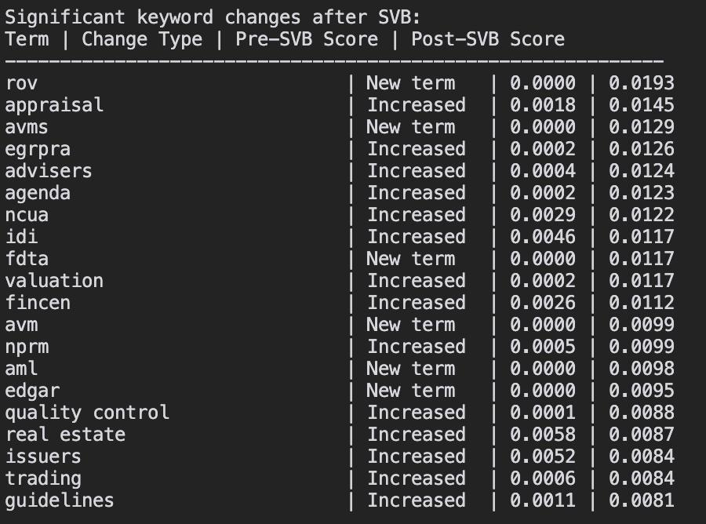
TF-IDF Results
In the post-SVB collapse, there were some terms that either became newly important, or became significantly more important than they were previously.
Many of these are acronyms which stand for specific financial phrases. Example: “rov” stands for “Reconsideration of Value”, which in the context of post-SVB regulations discusses the revaluation of assets in light of relevant and important information. Similarly, “avms” stands for “Automatic Valuation Models” as new regulations discuss which models are and are not appropriate for various situations.
Our results generally support the idea that regulators are paying far more attention to accurate valuation and assessment of financial institutions in order to avoid re-creating the circumstances where SVB appeared healthy from an external perspective prior to the sudden collapse.
Notes:
Harsh

Slide 16
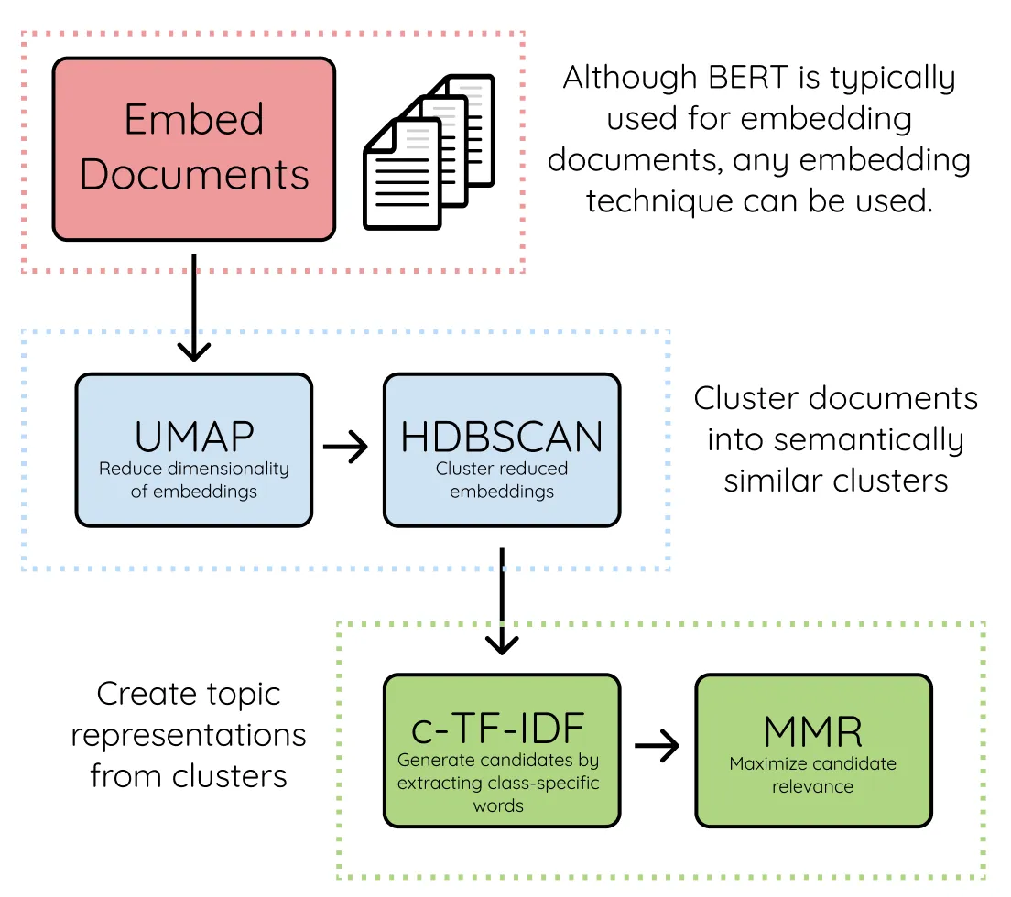
BERTOPIC
3 Key Aspects
Sentence Embeddings
Transforms text into dense vectors capturing semantic meaning
Leverages transformer models like Sentence-BERT for contextual understanding
Enables nuanced analysis of complex regulatory language
Dimensionality Reduction
Applies UMAP to make high-dimensional embeddings manageable
Preserves local structure and relationships in data
Facilitates efficient clustering of text into distinct topics
Topic Representation
Uses TF-IDF to extract interpretable keywords for each topic
Highlights the most relevant terms for understanding themes
Enables comparison of trends pre- and post-SVB
Notes:
Nic

Slide 17
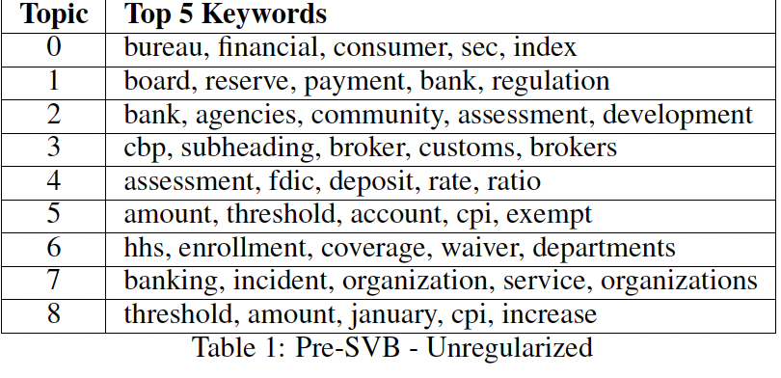
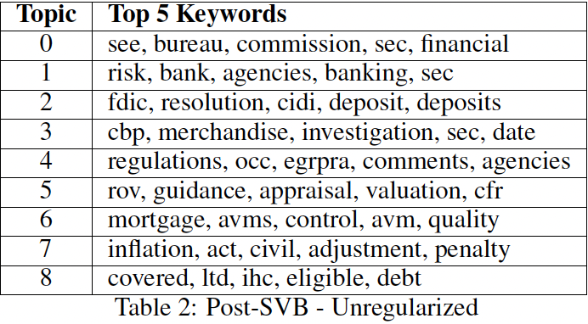
BERTOPIC
Post-SVB, regulatory focus shifted from broader community development to systemic risks and financial stability. Non-financial topics like health policy disappeared, while new issues such as debt compliance and mortgage control emerged, reflecting a concentrated response to financial risks.
Notes:
Nic

Slide 18
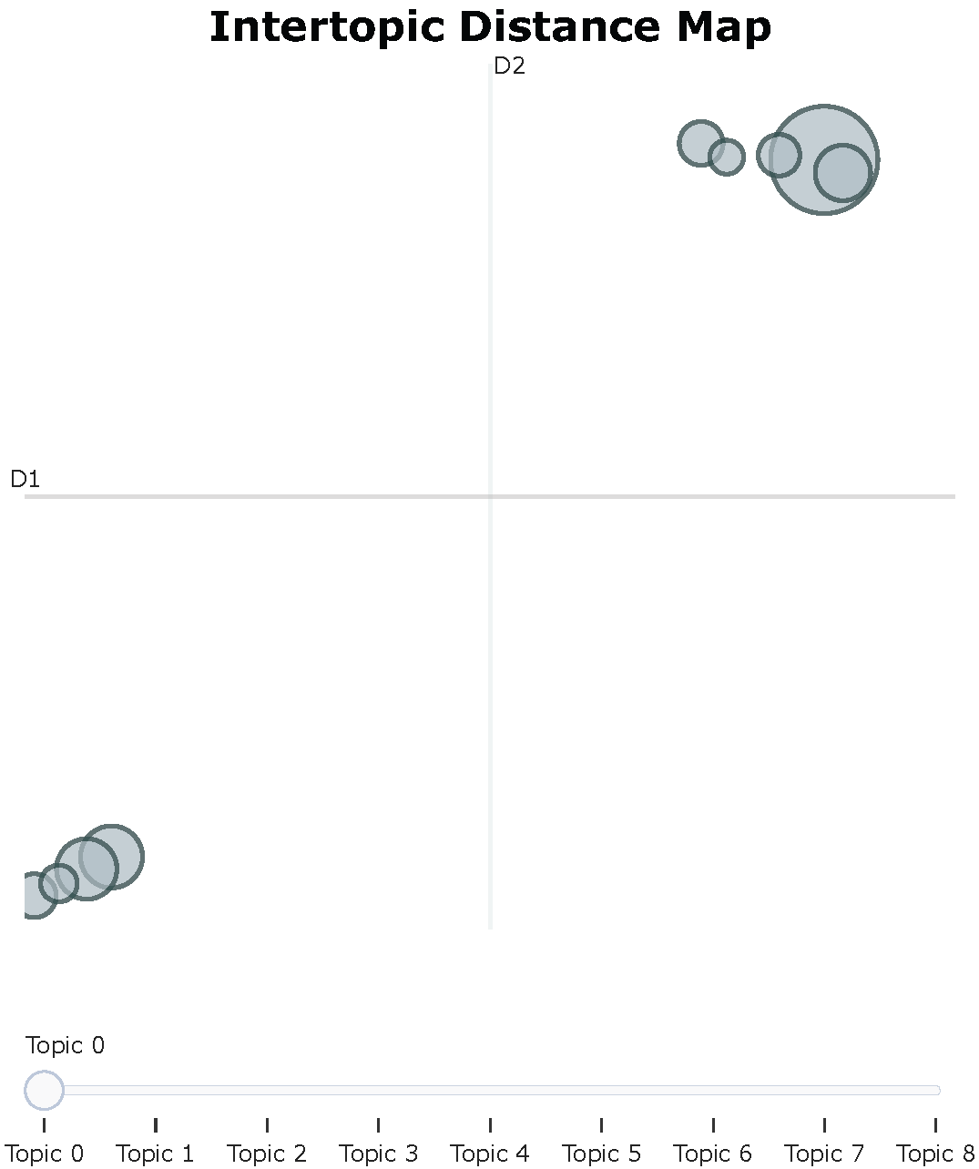
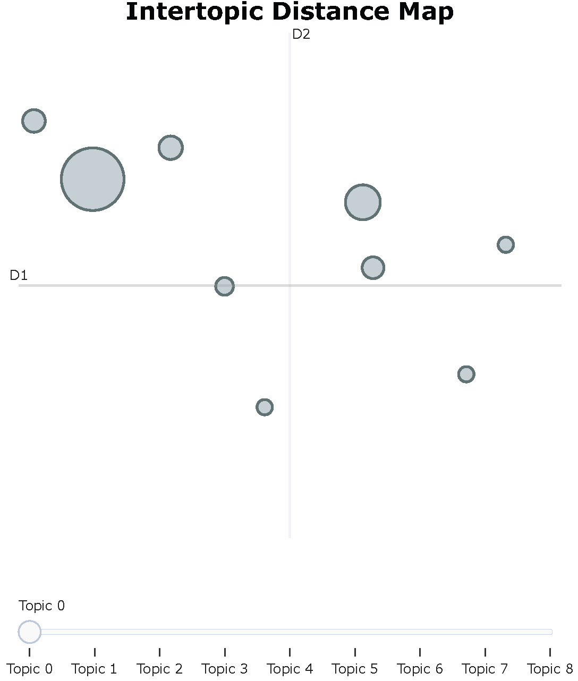
Evolving regulatory focus pre- vs post-svb
Pre-SVB, much more overlap, implying regulatory environment with less diversification in focus. Post-SVB, specificity fragments as different agencies/sectors began emphasizing unique aspects of financial stability and risk containment.

Slide 19
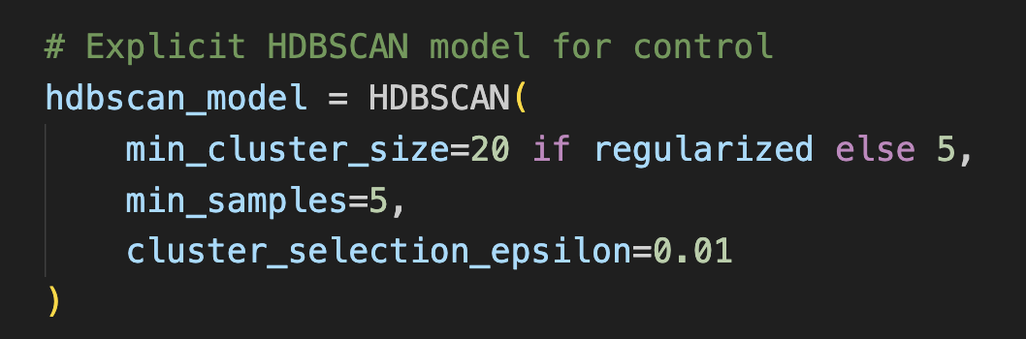
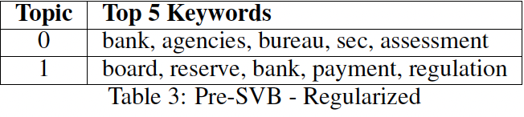
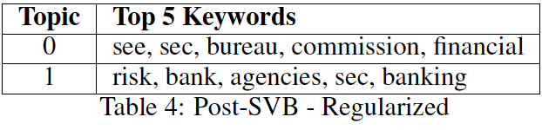
BERTOPIC (REGULARIZED)
Post-SVB, there is a stronger focus on systemic risk management, with keywords like "commission," "SEC," and "financial.", which aligns with unregularized findings.
Notes:
Nic

Slide 20
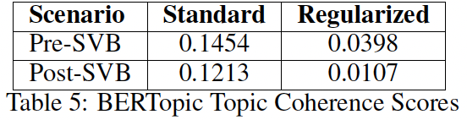
BERTOPIC VALIDATION
The unregularized model yields better coherence, indicating more meaningful topics, while the regularized model focuses on trends at the expense of semantic alignment.
Both models show higher coherence pre-SVB, highlighting the need for fine-tuning or alternative methods for analyzing complex regulatory text.
Notes:
Nic

Slide 21
CONCLUSION
 | Advantages | Limitations | Key Findings
Naive Baseline | - Simple and efficient | - Cannot capture complex patterns - Lacks semantic depth | Validated an increased regulatory focus on liquidity, capital requirements, and small banks.
TF-IDF | - Effective at identifying and prioritizing relevant terms by balancing frequency with rarity across the corpus. | - Ignores context and word order - Lacks semantic depth | Identified high-frequency terms and regulatory trends focused on more accurate valuation requirements.
BERTopic | - Captures nuanced and contextual semantics - Reveals hidden topics | - Computationally intensive - Requires significant fine-tuning | Highlighted shifts in focus on systemic risks and liquidity-related topics post-SVB.
Post-SVB, regulatory focus shifted to systemic risks, liquidity, and capital, impacting smaller banks. Financial institutions should use predictive tools, adapt to policy changes, and strengthen risk management to address similar crises.
Combining these three methods balances their strengths and compensates for individual limitations, offering a comprehensive perspective on regulatory shifts.

Slide 22
Limitations & Future Work
Expanding Corpus Size
Including other document types (notices) was considered, but document types show non-relevant topics such as regulation meeting alerts.
Comparative Analysis
This study focuses solely on the SVB collapse. Future research could expand to include comparative analyses of regulatory trends across similar financial crises, such as the Lehman Brothers collapse, to uncover consistent patterns.
Sentiment Analysis
Incorporating sentiment analysis of regulatory texts could help uncover the polarity and attitudes of regulators.
Enhanced Methodology
With improved computational resources, more rigorous hyperparameter tuning could be employed to enhance model performance.
Notes:
Nic

Slide 23

thank you
Q & A

